Slide 1
Labor Market Information
Workforce Strategy and Innovation Committee Update
January 2022

Slide 2

Advertised Job Openings-Omaha MSA
2019-December 2021 from Neworks.Nebraska.gov
-301, -0.8% November to December 2021
24,640
Current Openings as of January 18th, 2022

Slide 3
Job Openings Details-Omaha MSA
For January 18th, 2022, from Neworks.Nebraska.gov
Top Occupations
Top Employers
Occupation | Job Openings
Registered Nurses | 1,290
Nursing Assistants | 460
Teacher Assistants | 391
Customer Service Representatives | 381
Retail Salespersons | 355
Licensed Practical and Vocational Nurses | 306
Heavy and Tractor-Trailer Truck Drivers | 286
Security Guards | 251
Food Preparation Workers | 234
Physicians and Surgeons, All Other | 221
Employer Name | Job Openings
Omaha Public Schools | 894
Methodist Health System | 629
University of Nebraska Medical Center | 526
Nebraska Medicine | 459
CommonSpirit Health | 456
Immanuel | 449
Boys Town National Research Hospital | 368
Boys Town | 366
Children's Hospital & Medical Center | 242
First National Bank of Omaha | 204

Slide 4
Unemployment Rates-MSA’s
2019- November 2021 Unemployment Rates-Not Seasonally Adjusted
November 2021:
Omaha 1.5%
Lincoln 1.1%
Grand Island 1.2%
Nebraska: 1.2%

Slide 5
Labor Force, Employment, Unemployment
2019-November 2021 for Omaha MSA-Not Seasonally Adjusted
Labeled points for November 2019, February 2020, and November 2021; Changes from February 2020 to November 2021
+0.5% (+2,24)
-1.3% (-6,310)
-54.0% (-8,534)

Slide 6

Unemployment Rates
November 2021 Unemployment Rates by County-Not Seasonally Adjusted
Thurston 1.8%
3rd
Douglas 1.4%
18th
Washington 1.1%
18th
Sarpy 1.1%
Rock 0.6%
1.2%
3.9%
Seasonally Adjusted: Nebraska: 1.8%, US: 4.2%

Slide 7
Employment
2019-November 2021 Employment for Omaha MSA-Not Seasonally Adjusted
Labeled points for November 2019, February 2020 and November 2021; Changes from February 2020 to November 2021
+1.6% (+1,000)
+0.4% (+2,000)
+0.2% (+1,000)

Slide 8
Not Back to February 2020 levels
2019-November 2021 Employment for Omaha MSA-Not Seasonally Adjusted
Labeled points for November 2019, February 2020 and November 2021; Changes from February 2020 to November 2021
-5.8% (-600)
-4.1% (-1,900)
-3.8% (-1,900)
-2.1% (-1,400)

Slide 9
Back to February 2020 levels
2019-November 2021 Employment for Omaha MSA-Not Seasonally Adjusted
Labeled points for November 2019, February 2020 and November 2021; Changes from February 2020 to November 2021
+0.3% (+100)
+0.5% (+400)
+0.5% (+100)
+1.8% (+1,300)

Slide 10
Back to February 2020 levels
2019-November 2021 Employment for Omaha MSA-Not Seasonally Adjusted
Labeled points for November 2019, February 2020 and November 2021; Changes from February 2020 to November 2021
+3.1% (+900)
+5.3% (+5,000)

Slide 11
Median Hourly Wages by County
3rd Quarter 2021
Stanton $22.44
2nd
Douglas $21.76
4th
Sarpy $21.52
22nd
Washington $19.44
Keya Paha $10.29
$20.15

Slide 12
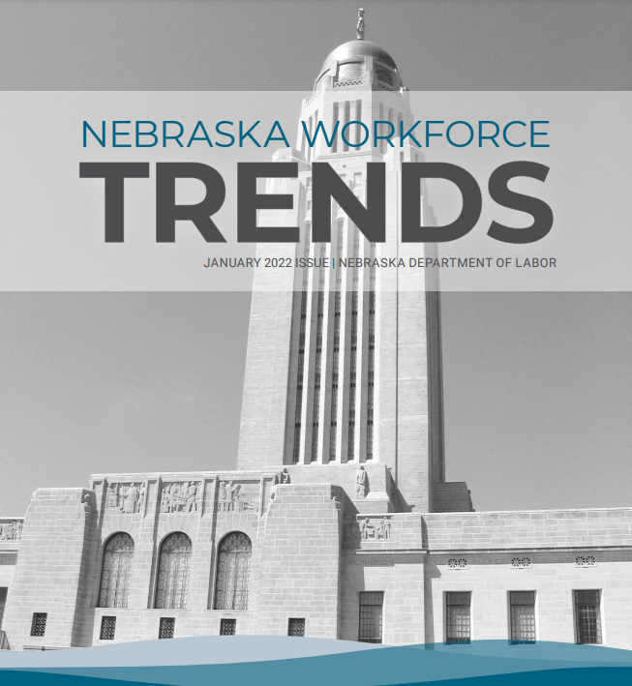
January 2022 Topics
Labor Market Data Rankings
Spotlight on H3
Openings & Expansions
Map Facts: Labor Force Participation by State
Link: https://dol.nebraska.gov/trends

Slide 13
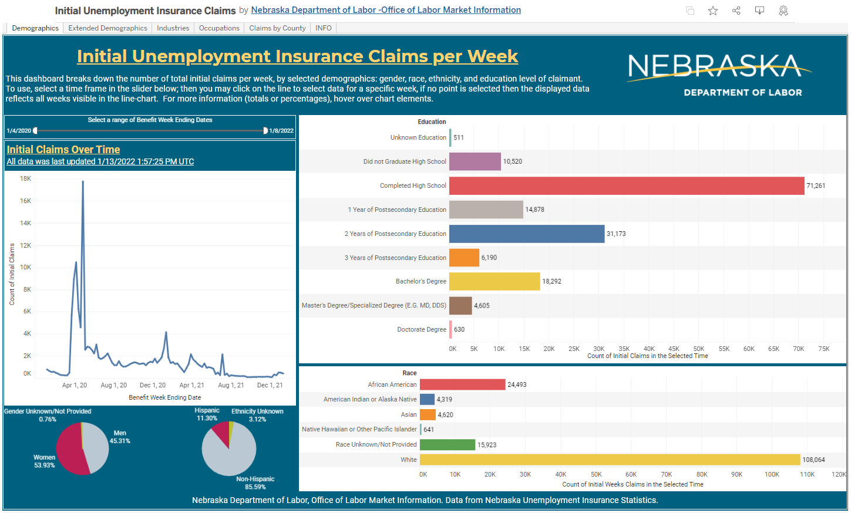
Updated Unemployment Insurance Claims Dashboards
Two new Tableau Dashboards
  Initial Claims
  Continued Claims
Updated on Thursdays
These and other dashboards can be found at: https://public.tableau.com/app/profile/ndollmi

Slide 14

Contact
Jodie Meyer
Research Analyst II
Office of Labor Market Information
402-471-9629
Jodie.Meyer@nebraska.gov

