Slide 1
Better Business Workshop Series: Utilizing wage, benefit, and labor availability data to help your business stay competitive
Jodie Meyer, Research Analyst
Scott Ferguson, Research Analyst
August 2022

Slide 2
What is LMI?
Labor Market Information
It is any data or analysis that relates to the workforce
Employment
Unemployment
Labor Force
Wages
Projections
Demographics
Business characteristics
Commuting patterns
And so much more!

Slide 3
Why Use LMI?
Track local and national economic conditions
Learn future needs
See what area wages typically are to set/adjust pay for employees
Learn the demographics of your area and potential workforce
Determine what benefits to offer
Guide employee recruitment efforts
Establish business locations
Learn the cost of living where business is located
And more!

Slide 4
For Occupations: Occupational Employment and Wage Statistics (OEWS)
What is it:
Employment and wage estimates for nearly 800 occupations
Updated:
Wage Data – Quarterly
Employment - Annually
Where does it come from:
Survey of employers
How to use it:
To make decisions on pay rates
Available for:
Nebraska, Economic Regions, MSA’s, County Level
Not included:
Self-employed, some agricultural workers, and private household workers

Slide 5
Wages: Omaha MSA (NE: Cass, Douglas, Sarpy, Saunders, Washington, IA: Harrison, Mills, Pottawattamie) Total All Occupations 2nd Quarter 2022 Source: Nebraska Department of Labor, Occupational Employment Wage Statistics
Average: $27.93 hourly
$58,097 annual
Entry: $13.73 hourly
$28,566 annual
Median: $22.27 hourly
$46,319 annual
Experienced: $35.04 hourly
$72,864 annual
Statewide: Average-$26.48/$55,077; Entry-$13.44/$27,956; Median- $19.71/$31,361; Experienced-$33.00/$68,638

Slide 6
Omaha MSA Average Hourly Wage by Major Occupational Group

Slide 7
Hourly Entry and Experienced Wages

Slide 8
Finding Occupational Wages: Statewide, Regions, and Metros
Go to: NEworks.Nebraska.gov
1
Under Labor Market Information, click on “Labor Market Analysis”
2
From the quick link buttons in the upper right, click “Occupational Employment & Wages”
3

Slide 9
Living Wage
Created by MIT
Estimates the cost of living based on typical expenses
Has State, County, and Metro data
Displays data for different family compositions
Shows typical expenses and typical annual salaries
Online: https://livingwage.mit.edu/

Slide 10
Cost of Living
Council for Community and Economic Research (C2ER) Cost of Living Index
Full/historical datasets can be purchased through them https://www.coli.org/
A few websites provide parts of the data set for free
CNN Money-basic https://money.cnn.com/calculator/pf/cost-of-living
Bankrate-more detailed https://www.bankrate.com/real-estate/cost-of-living-calculator/

Slide 11
What is the Labor Availability Study (LAS)?
A research project created in 2016 by the Nebraska Legislature to gather and publish data on the state’s business and labor force needs.
A collaboration between:
Nebraska Depts of Labor and Economic Development
UNL Bureaus of Sociological and Business Research
Local economic developers and other community stakeholders

Slide 12
Data Produced by LAS
Hiring and Training Needs
Reasons for Difficulty Hiring
Labor Availability
Barriers to Obtaining Training
Important Factors/Obstacles When Considering Jobs
Skills Gaps
Surplus/Deficits in Workforce and Education Opportunities
Benefits
Commuting/Teleworking
Workforce Skill Levels

Slide 13
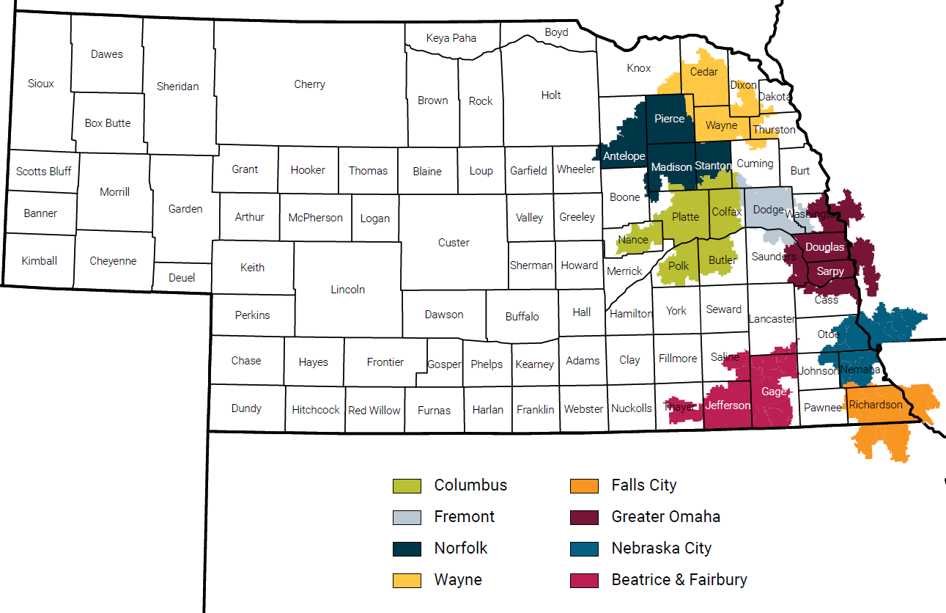
2021-2022 Survey Areas
Notes:
Moving across the state every 3 years

Slide 14
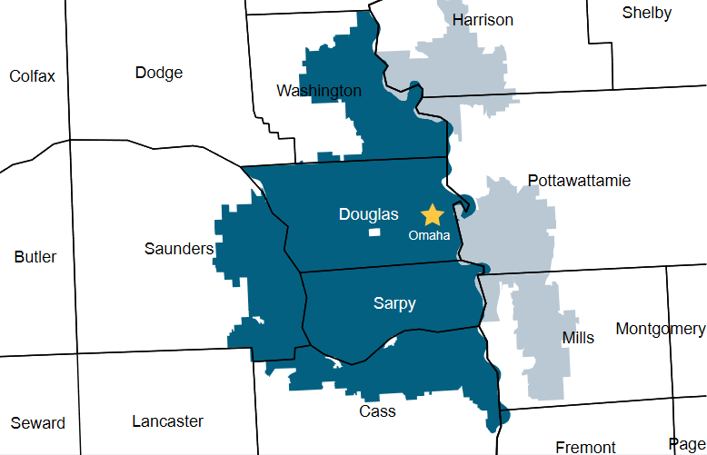
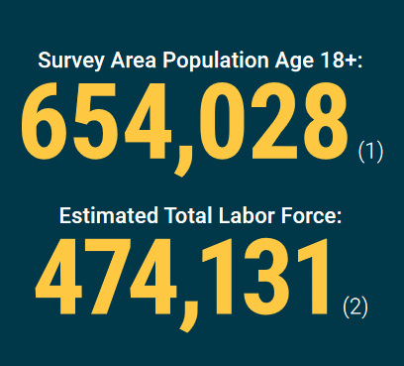
Greater Omaha Survey Area
Survey conducted between December 2021 – February 2022
1,593 businesses and 1,189 households responded
Sources:
1. U.S. Census Bureau. American Community Survey, 2019 5-Year Estimates. Table DP05. [Online] data.census.gov.
2. Nebraska Department of Labor. Labor Market Information, LAUS and U. S. Census Bureau data analysis.
Notes:
Area includes: Ashland, Bellevue, Blair, Elkhorn, Gretna, La Vista, Omaha, Papillion, Plattsmouth, Ralston + others.

Slide 15
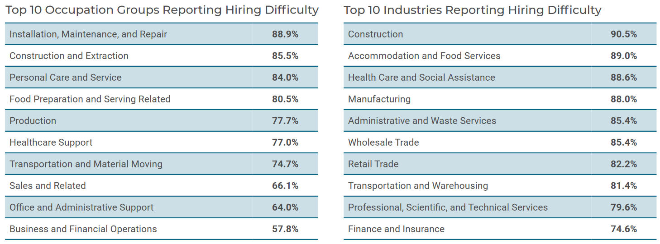
Hiring Difficulty in Greater Omaha
84.1% of employers reported it was difficult to find workers for at least 1 occupation.
71.6% of frequently hired jobs were difficult to fill.
Notes:
Businesses listed up to three occupations they have recently hired or attempted to hire. They were asked whether it was difficult to find workers for those occupations.

Slide 16
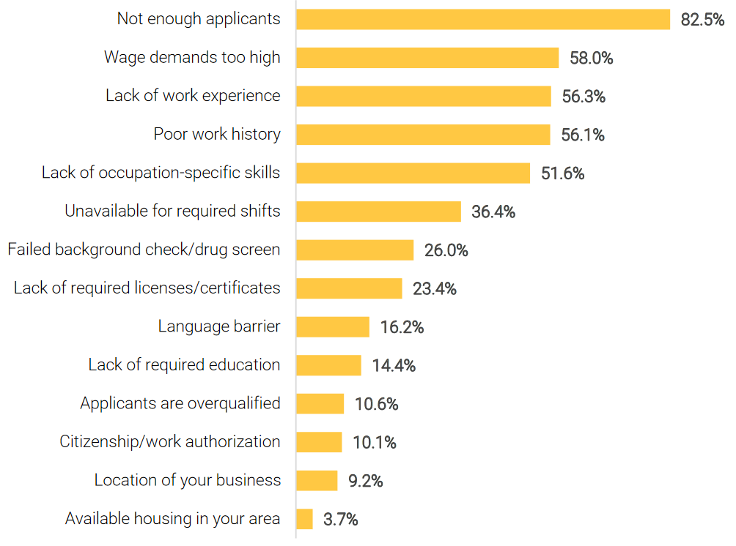
Reasons for Difficulty Hiring

Slide 17
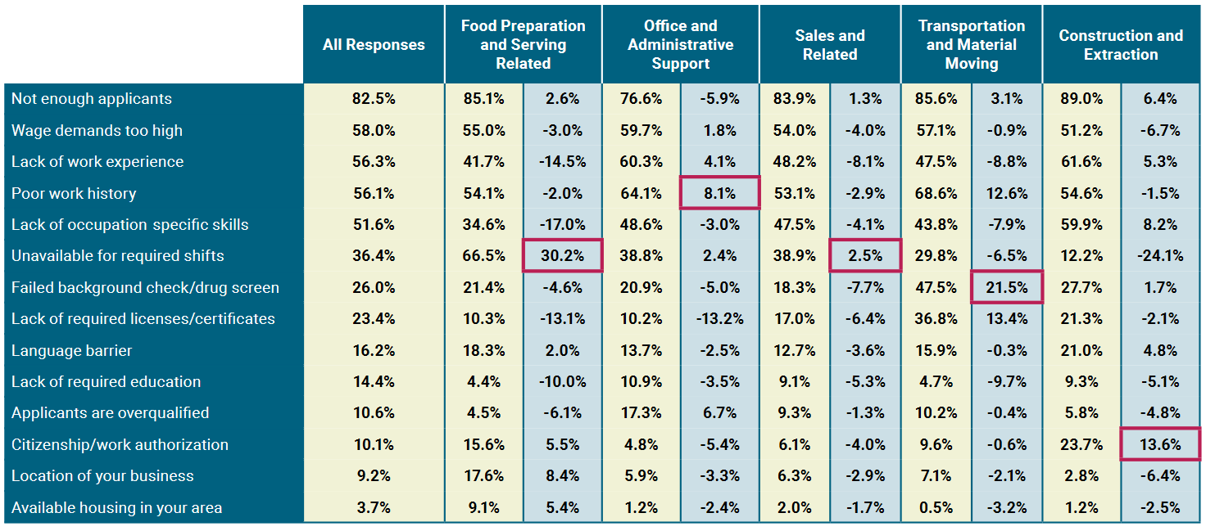
Difficulty Hiring by Occupation Group
Percentage point difference between occupation group and all occupations
Most prominent difficulty for occupation group compared to all occupations
Notes:
The table below displays the reasons businesses had difficulty hiring workers in the five occupation groups they most often hired or tried to hire.

Slide 18
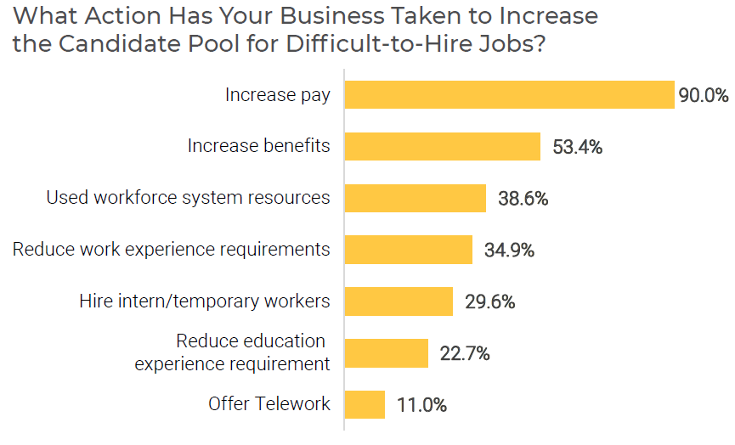
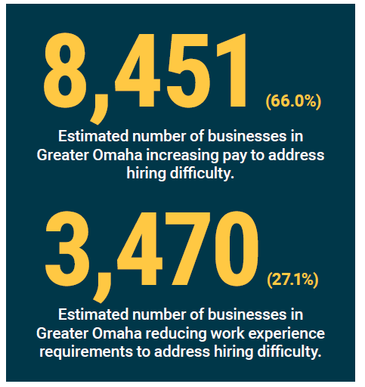
Addressing Difficulty Hiring

Slide 19
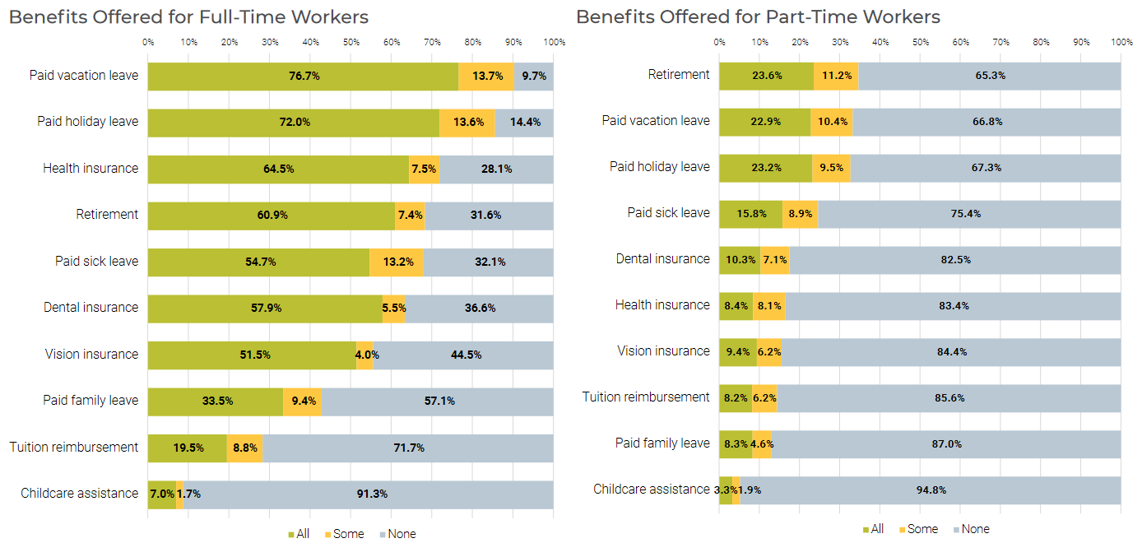
Benefits Offered to Employees

Slide 20
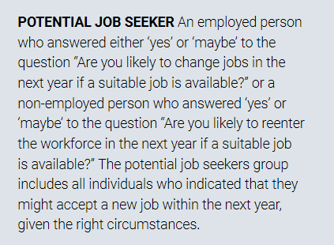
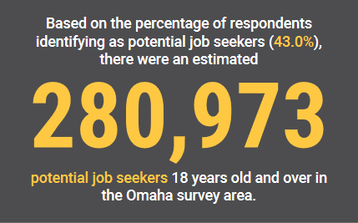
Potential Job Seekers

Slide 21
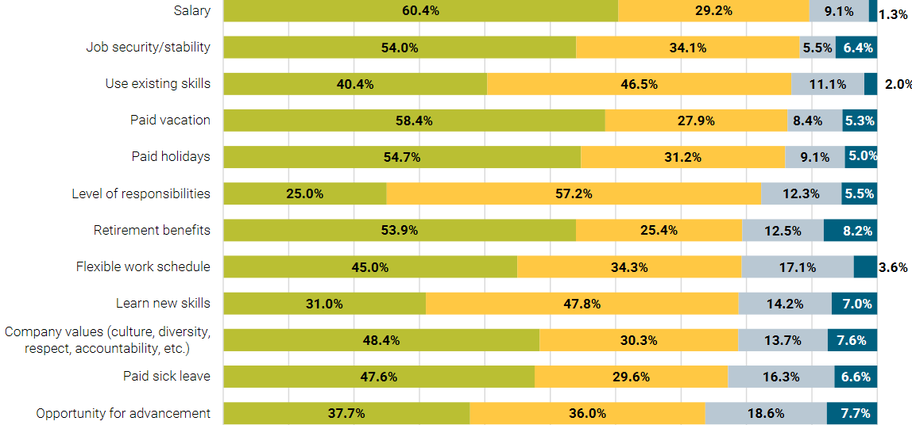
Important Factors for Potential Job Seekers

Slide 22
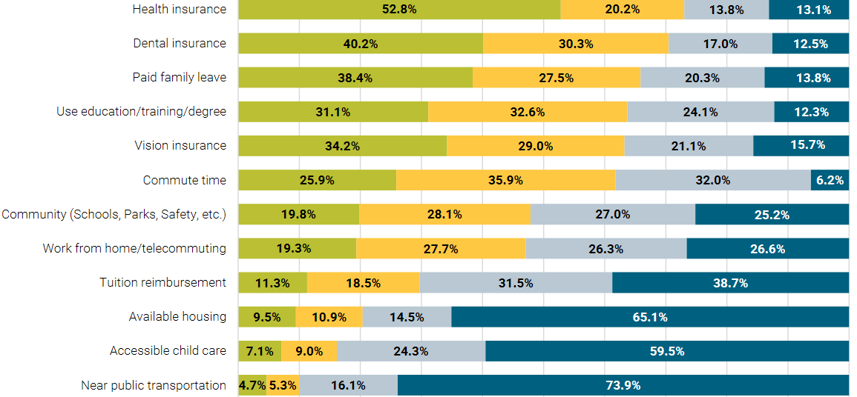
Important Factors for Potential Job Seekers

Slide 23
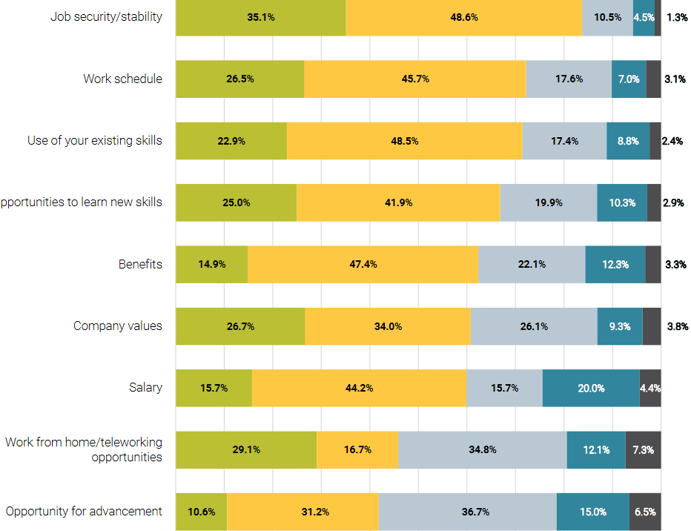
Job Satisfaction Factors for Employed Potential Job Seekers

Slide 24
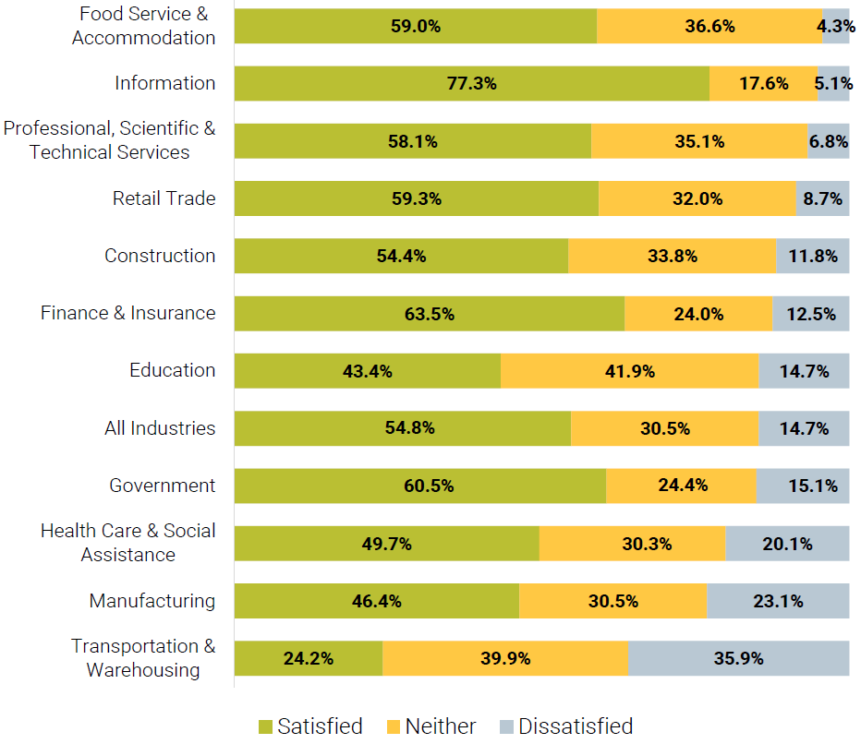
Job Satisfaction – Opportunities for Advancement, by Industry

Slide 25
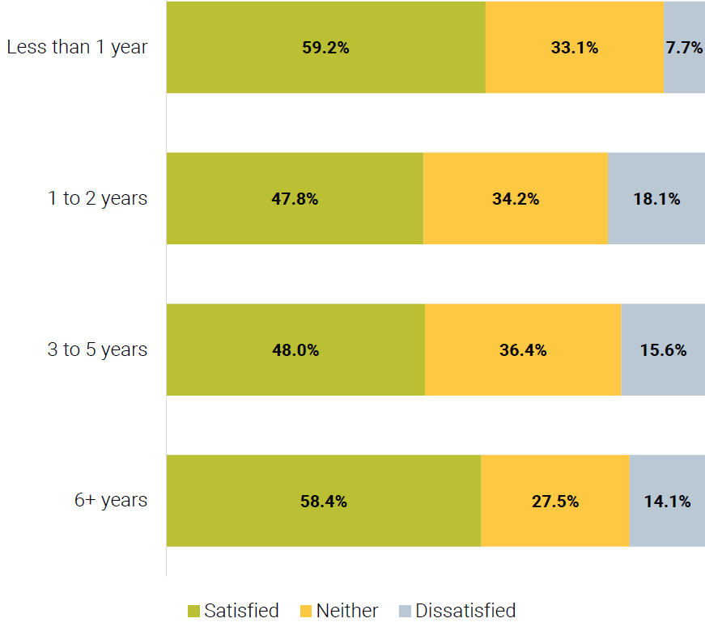
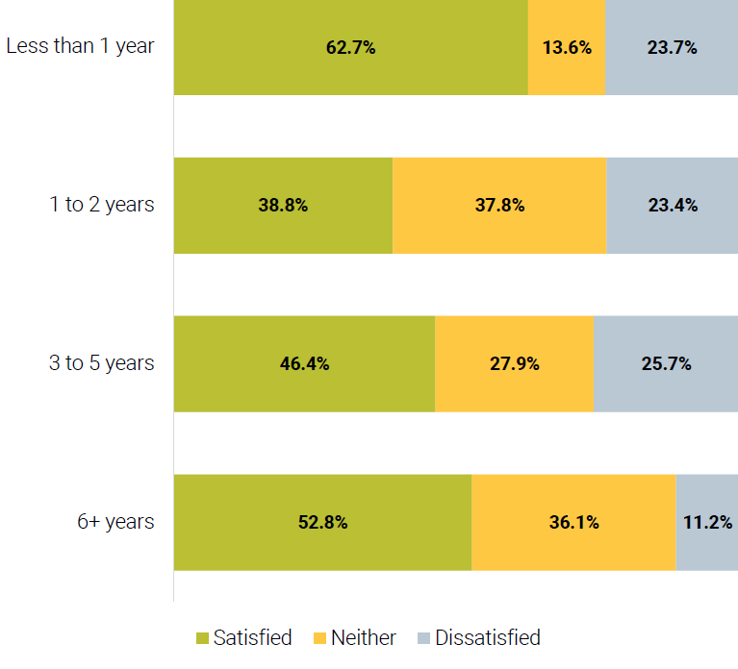
Job Satisfaction – Opportunities for Advancement
By Length of Employment
Healthcare and Social Services Workers

Slide 26
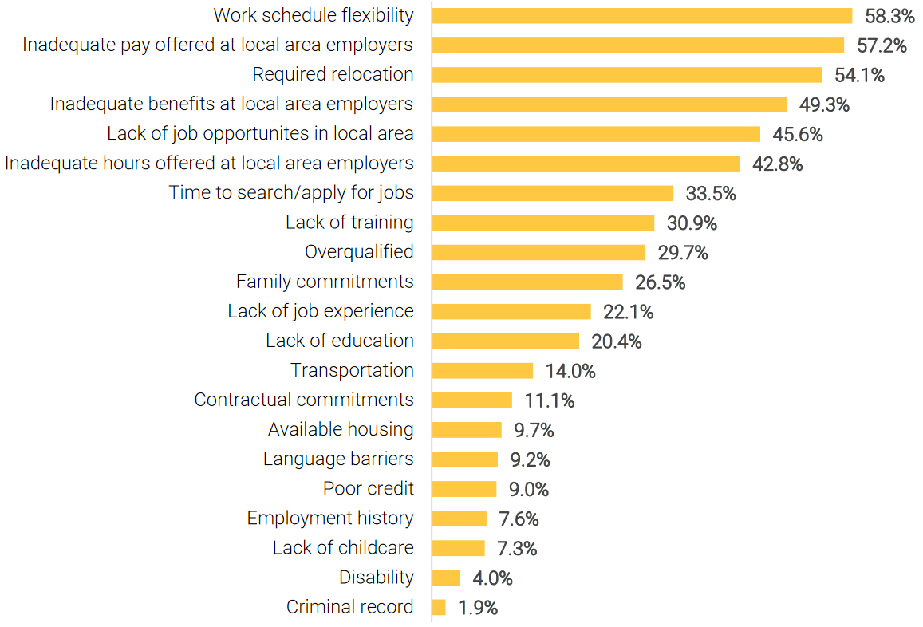
Obstacles to Employment
Factors preventing workers from finding or accepting new employment opportunities

Slide 27
Regional Labor Availability
Potential Job Seekers were asked:
“If you were offered a job in Greater Omaha that met your most important criteria, would you consider accepting it?”

Slide 28
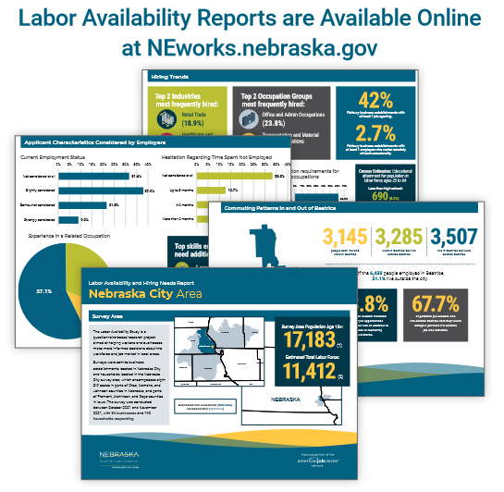
Statewide LAS Reports (2020-2021)
Recent articles have included:
LAS Results on Telework in Greater Omaha and the Northeast Region (June 2022)
Pandemic Impacts on Hiring (July 2021)
Pandemic Impacts on the Manufacturing Industry (October 2021)
Customized analysis of LAS survey results (by Industry, Occupation Group, Geography, etc.) is available upon request!

Slide 29
Finding NEworks Publications
Go to: NEworks.Nebraska.gov
1
Under Labor Market Information, click on “Labor Market Analysis”
2
From the quick link buttons in the upper right, click “Publications”
3

Slide 30
Contact
Scott Ferguson
Research Analyst II
Office of Labor Market Information
402-471-9947
Scott.Ferguson@nebraska.gov
Jodie Meyer
Research Analyst II
Office of Labor Market Information
402-471-9629
Jodie.Meyer@nebraska.gov

